Slide 1
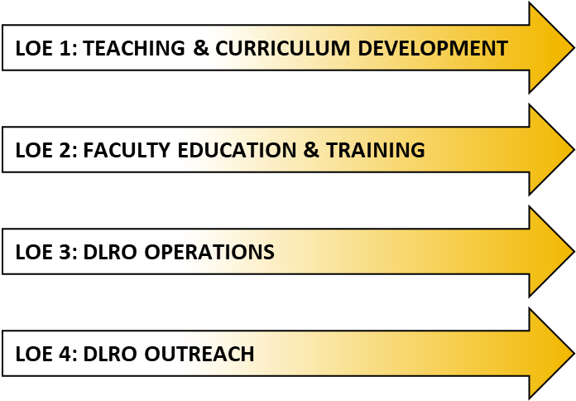
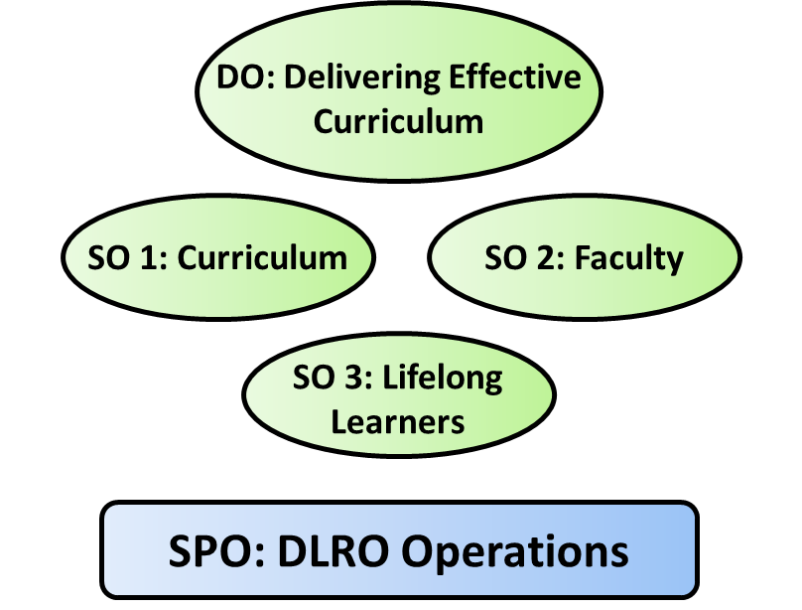
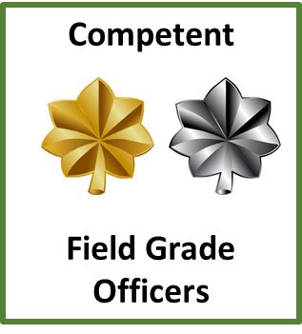
DLRO Campaign Plan
Mission (DRAFT):
The Department of Logistics and Resource Operations (DLRO) produces competent field grade officers by delivering current and relevant sustainment and force management curriculum in the US Army Command and General Staff Officer’s Course (CGSOC) today to win in Large Scale Combat Operations (LSCO).
Vision (DRAFT):
DLRO produces Stewards of the Profession who can generate and maintain combat power to provide options for Combatant Commanders in LSCO.
DLRO LINES OF EFFORT
DLRO OP FRAMEWORK
ENDSTATE
DLRO Feedback
Loop

